Slide 1
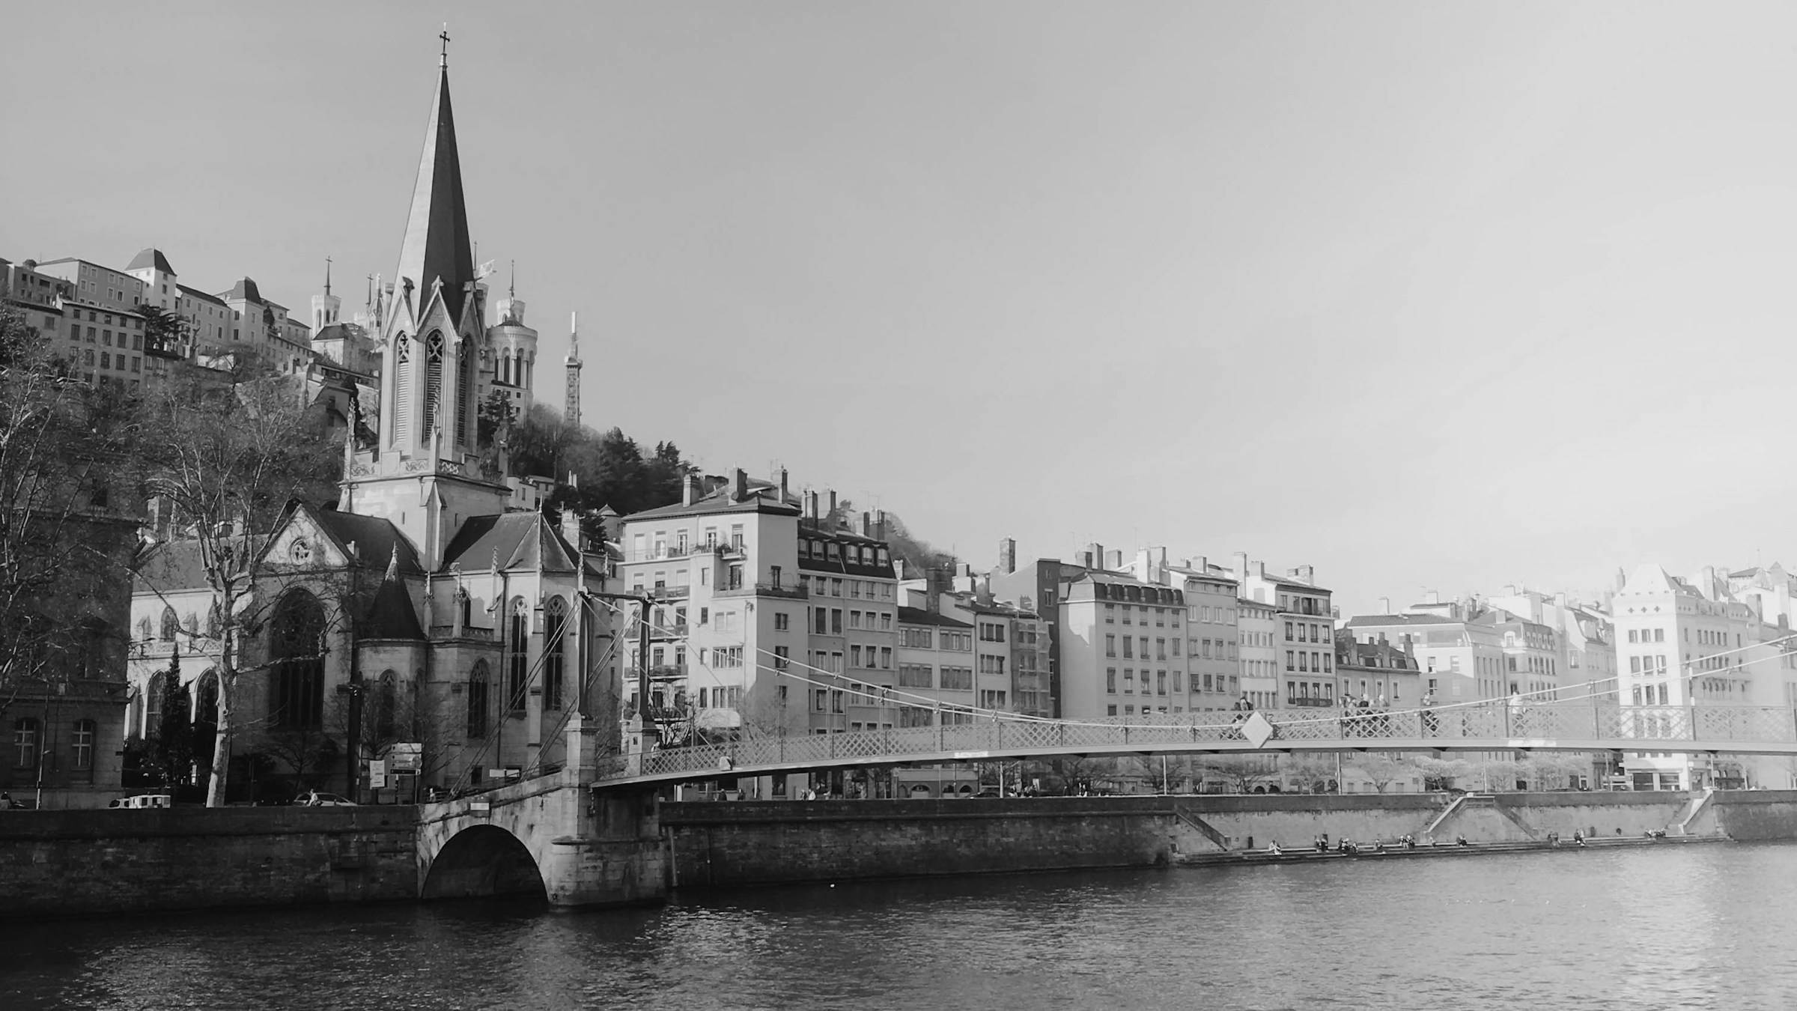
Distant Viewing: Opportunities and Challenges
Taylor ARNOLD + Lauren TILTON
Virtual/Material: What Matters for Art History?
Salle Rhône 3B
Lyon, France
26 June 2024, 09h > 10h30

Slide 2

1. Introduction
01 – Distant Viewing | Introduction

Slide 3
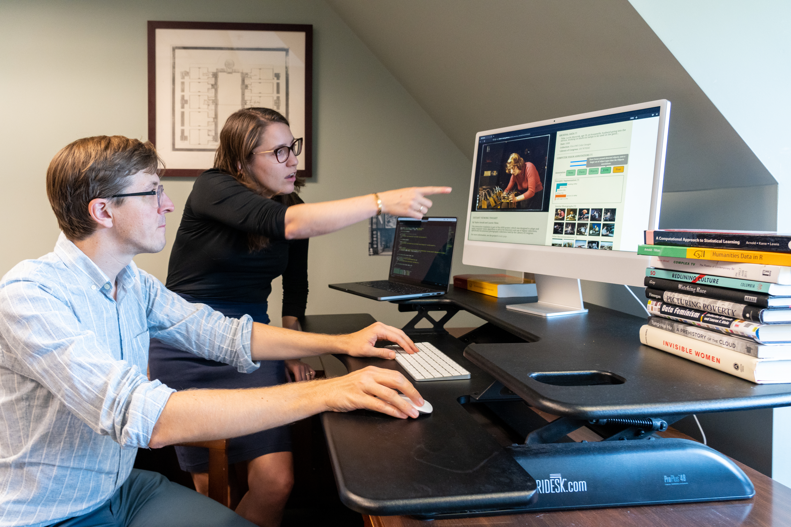
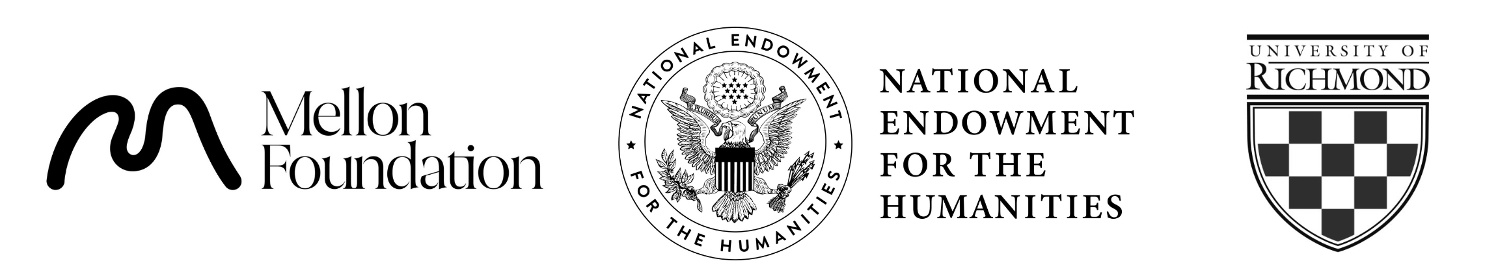
Distant Viewing Lab
The Distant Viewing Lab uses and develops computational techniques to analyze visual culture on a large scale.
We develop tools, methods, and datasets that can be re-used by other researchers. The lab engages closely with critical cultural and data studies, aiming to make explicit the interpretive act of algorithmic logic.
distantviewing.org
Generously supported through funding from:
01 – Distant Viewing | Introduction

Slide 4
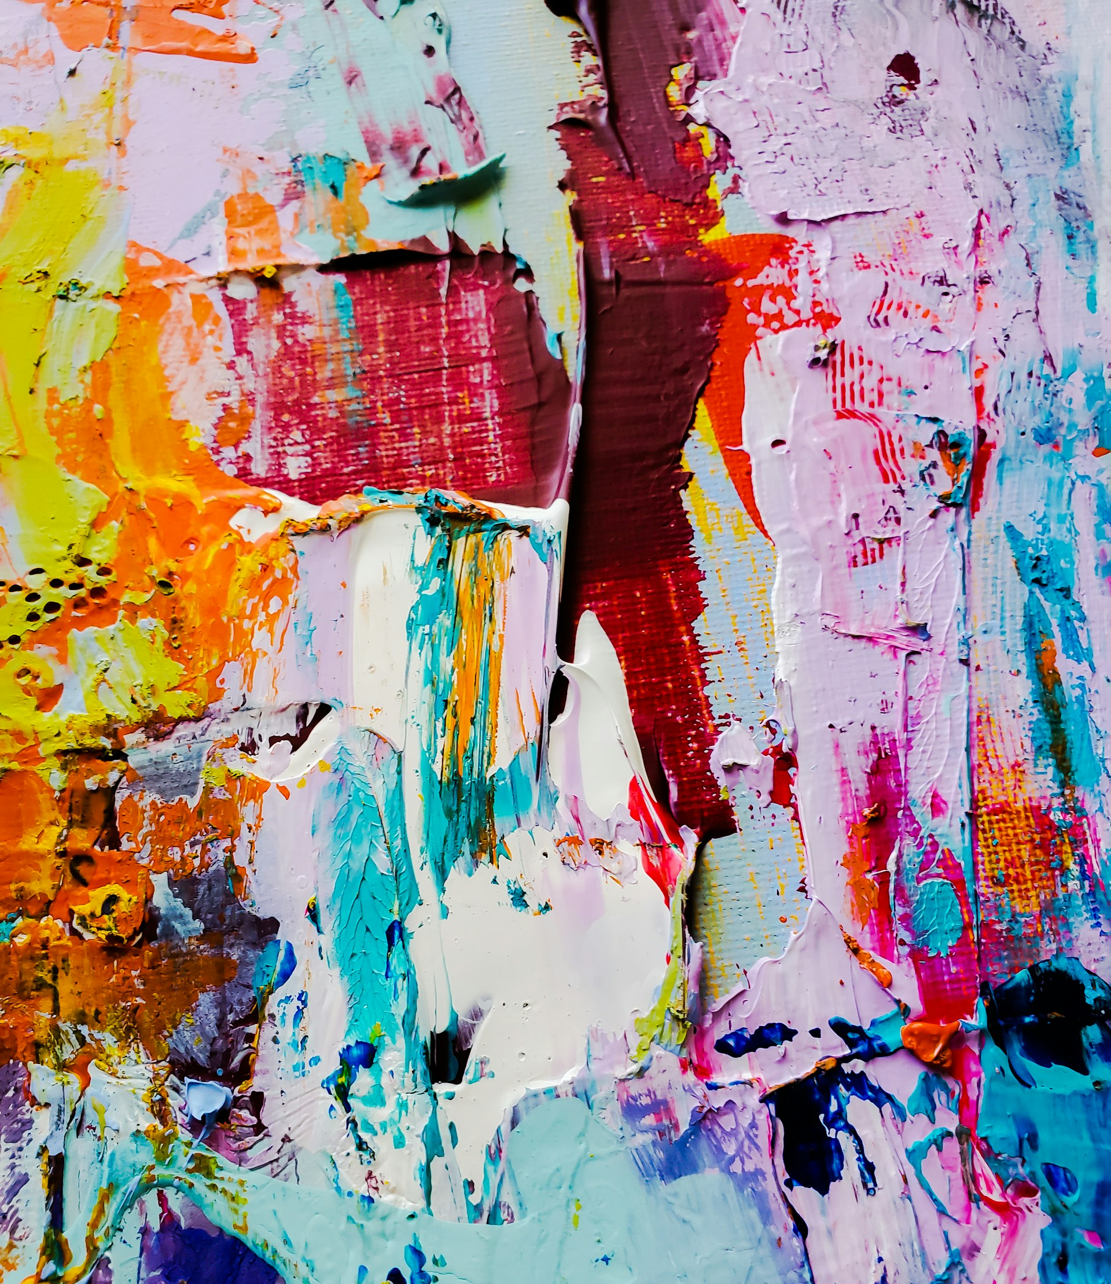
Today’s Talk
Distant viewing offers a framework for thinking about how objects are represented as data. Today we will summarize and apply this method to consider the following questions:
What happens when color, texture, and composition are turned into a collection of pixels/numbers?
How does relying on the digital surrogate dematerialize/materialize the work?
Can integrating close viewing with distant viewing offer opportunities to think critically about materiality?
What possibilities are made available for increased access and discovery of large digitized public collections?
Jené Stephaniuk, Cityscape (2020);
01 – Distant Viewing | Introduction

Slide 5
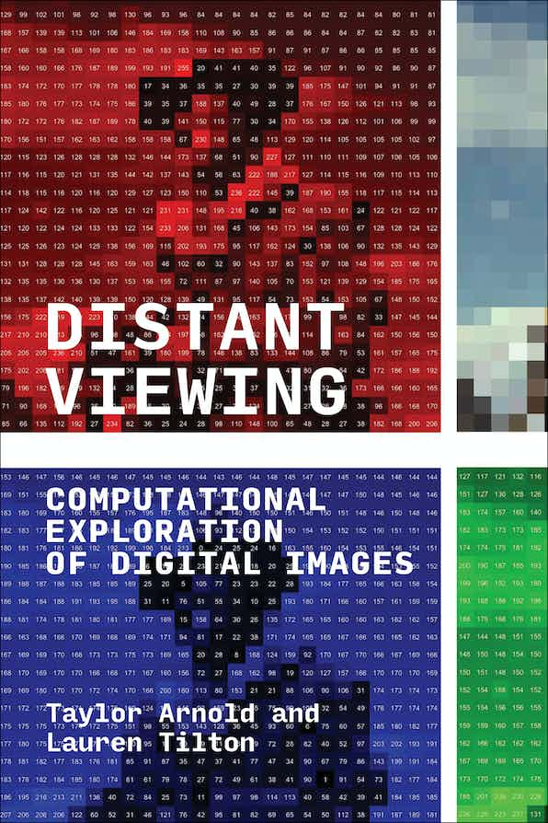
Distant Viewing Book (2023)
For more details, please check out our recently published book Distant Viewing (MIT Press, 2023). It has been released under an OA license and can be freely downloaded from the following link:
distantviewing.org/book/
Distant Viewing: Computational Exploration of Digital Images
By Taylor Arnold, Lauren Tilton
The MIT Press
DOI: https://doi.org/10.7551/mitpress/14046.001.0001
ISBN electronic: 9780262375160
In Special Collection: CogNet
Publication date: October 2023
01 – Distant Viewing | Introduction

Slide 6
2. Theory
02 – Distant Viewing | Theory

Slide 7
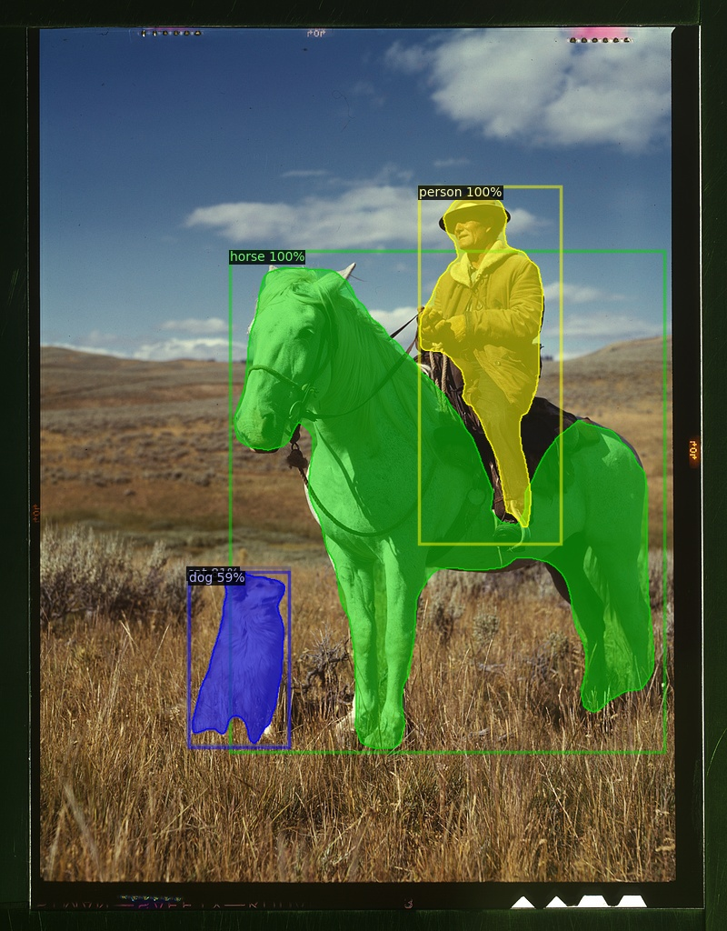
Theory: Overview
Distant Viewing is a theory of how computational exploration of digital images through the application of computer vision works, and why it is needed.
Mimetic nature of images necessitates that the computational analysis of digital images starts with the extraction of semantic metadata using computer vision.
The process of constructing annotations is a computationally mediated form of “viewing”
The application of computer vision is not a neutral process. It engages in socially mediated ways of seeing and viewing that are encoded into the algorithms and the ways that they are used.
02 – Distant Viewing | Theory

Slide 8
3. DV in Action
03 – Distant Viewing | DV in Action

Slide 9
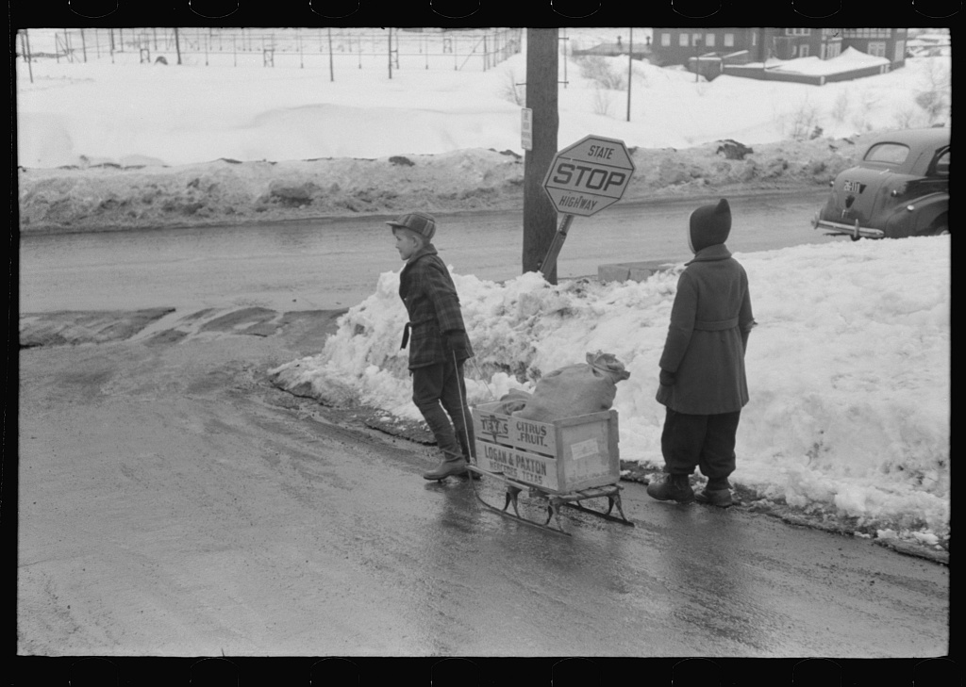
Example: FSA-OWI Archive
Let’s now see how a computational analysis can yield new insights about large visual collections by looking at the FSA-OWI photographic archive. This is a set of over 170k documentary photographs taken by the US Federal Government between 1935 and 1943.
We use computer vision algorithms to tag each image with a set of annotations about the objects contained in the frame.
03 – Distant Viewing | DV in Action

Slide 10
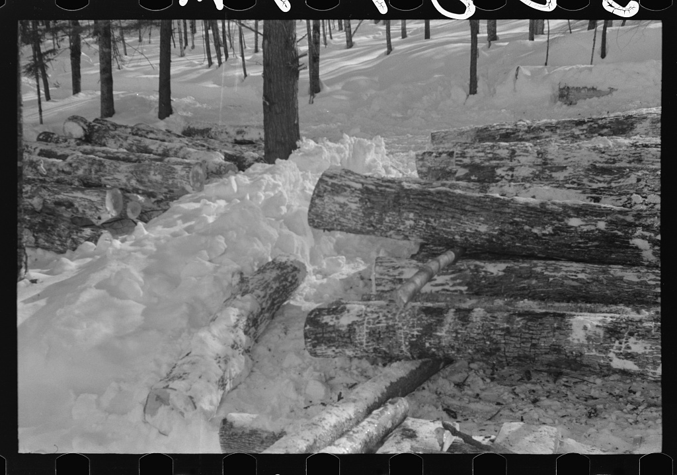
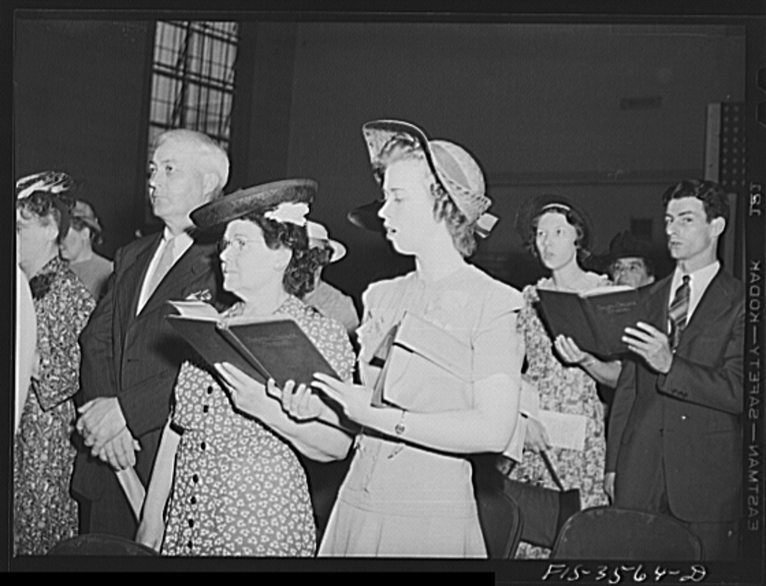
Computer Vision Annotations
Example annotations from three of the images contained in the FSA-OWI collection.
We applied these algorithms to all 170k digitized photographic negatives.
LOCATION: OUTSIDE
PEOPLE: 2
OBJECTS: snow, sled
LOCATION: OUTSIDE
PEOPLE: 0
OBJECTS: snow, logs
LOCATION: INSIDE
PEOPLE: 7+
OBJECTS: book, hat, suit
03 – Distant Viewing | DV in Action

Slide 11
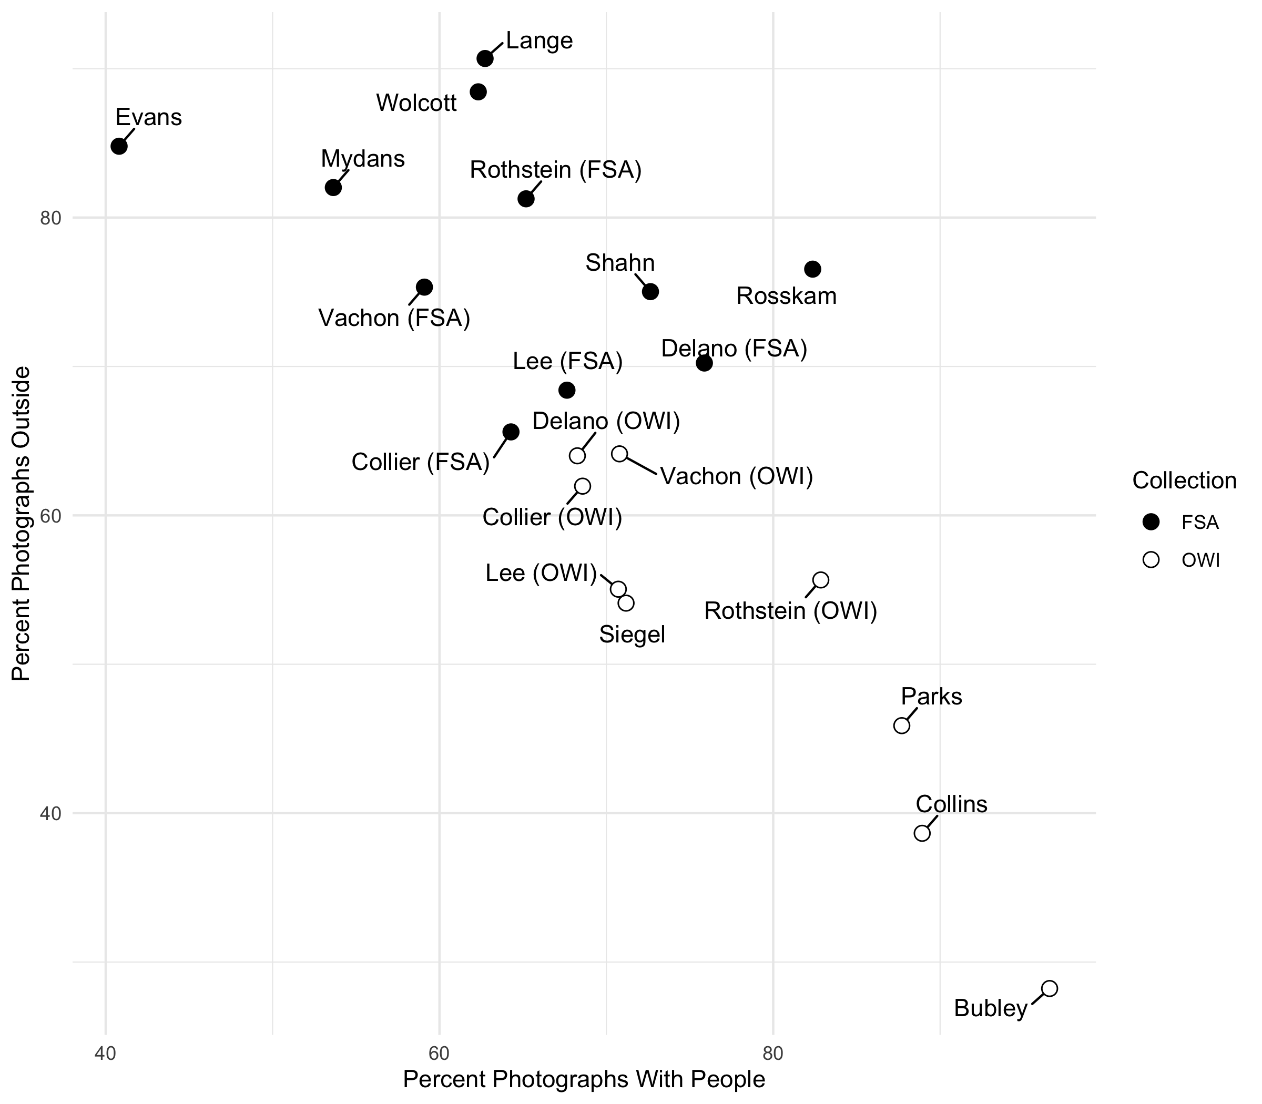
Data Analysis
Looking at the composition of the photographs by the photographer and phase of the project (FSA: New Deal; OWI: WWII) shows a strong pattern.
As the program progressed, there was a decreased focus on the land and increased focus on people.
Individual photographers somewhat followed the changing direction of the project, though continued to have there own noticeable style and focus.
03 – Distant Viewing | DV in Action

Slide 12
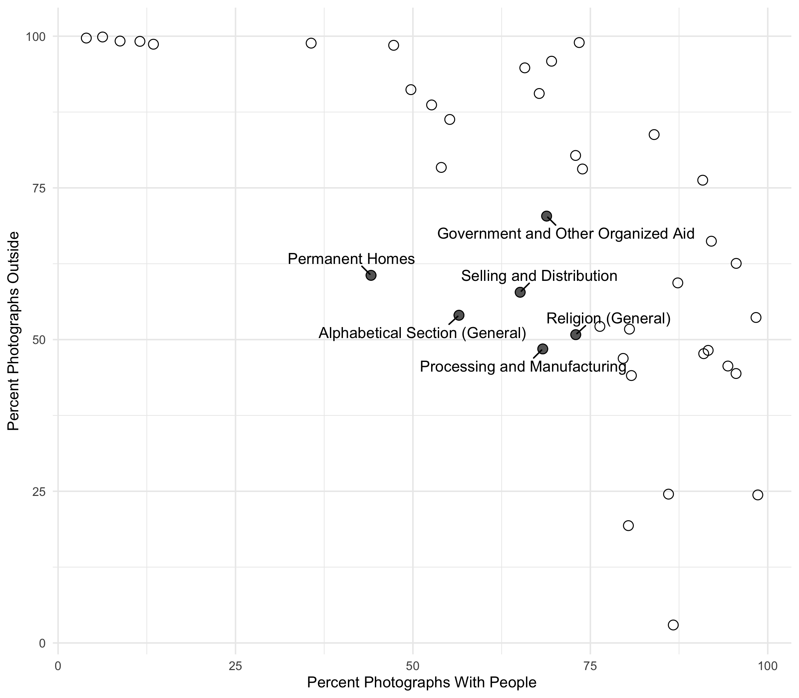
Data Analysis
These two tags also map very well onto the organizational logic of the FSA-OWI archive as constructed by Paul Vanderbilt between 1944 and 1954.
Only a handful of topics are not strongly associate with either a high percentage of people or a high percentage of photographs outside (or both), and these are mostly miscellaneous categories themselves.
03 – Distant Viewing | DV in Action

Slide 13
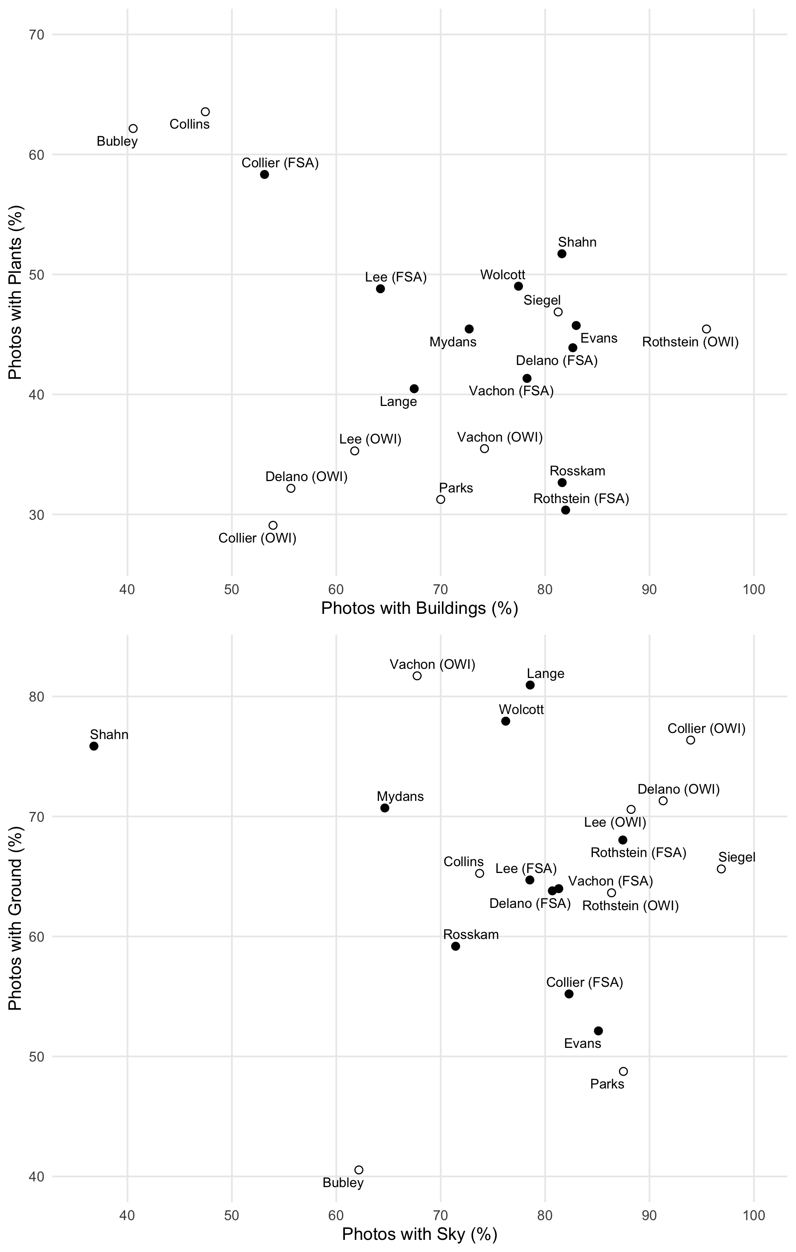
Data Analysis
Digging deeper, we see that the specific composition of the individual photographers does not align with the changing focus of the US governmental programs, but rather shows a personal style associated with each photographer.
For example, Shahn, Bubley, and Collier have particularly unique compositional elements to their photographs.
03 – Distant Viewing | DV in Action

Slide 14
Data Analysis
Digging deeper, we see that the specific composition of the individual photographers does not align with the changing focus of the US governmental programs, but rather shows a personal style associated with each photographer.
For example, Shahn, Bubley, and Collier have particularly unique compositional elements to their photographs.
To understand this better, we need to return to the photographic images themselves.
03 – Distant Viewing | DV in Action

Slide 15
4. Distant → Close
04 – Distant Viewing | Distant → Close

Slide 16
Perspective
The computational analysis helped us identify patterns in the photographic collection, but it is only through returning to the image themselves that we can fully understand.
04 – Distant Viewing | Distant → Close

Slide 17
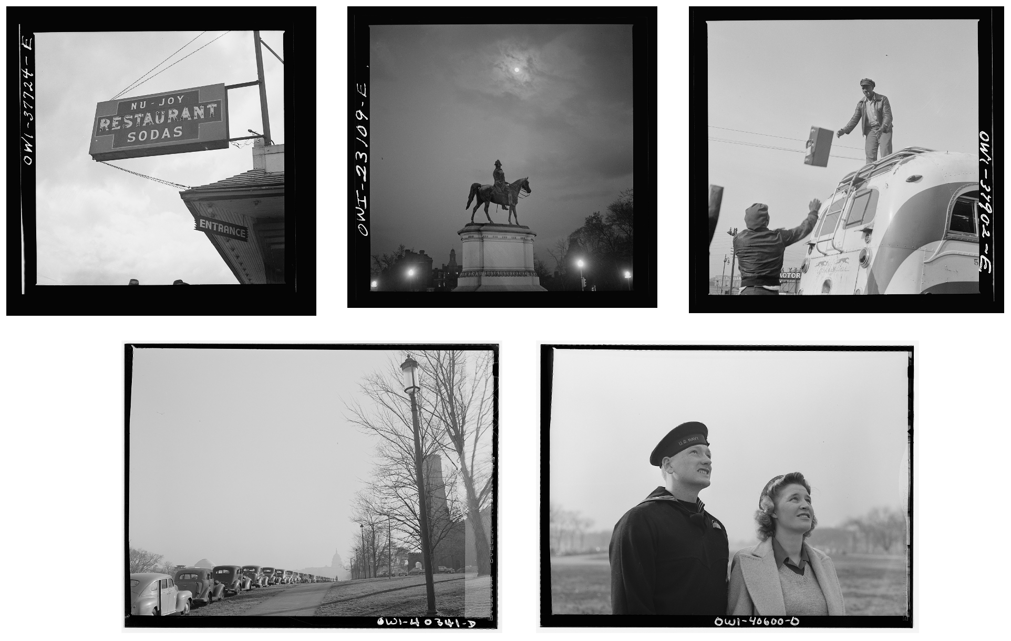
Perspective
The computational analysis helped us identify patterns in the photographic collection, but it is only through returning to the image themselves that we can fully understand.
Here, for example of some sample photographs from Esther Bubley. Notice the upwards camera angle and location of the horizon in the background.
04 – Distant Viewing | Distant → Close

Slide 18
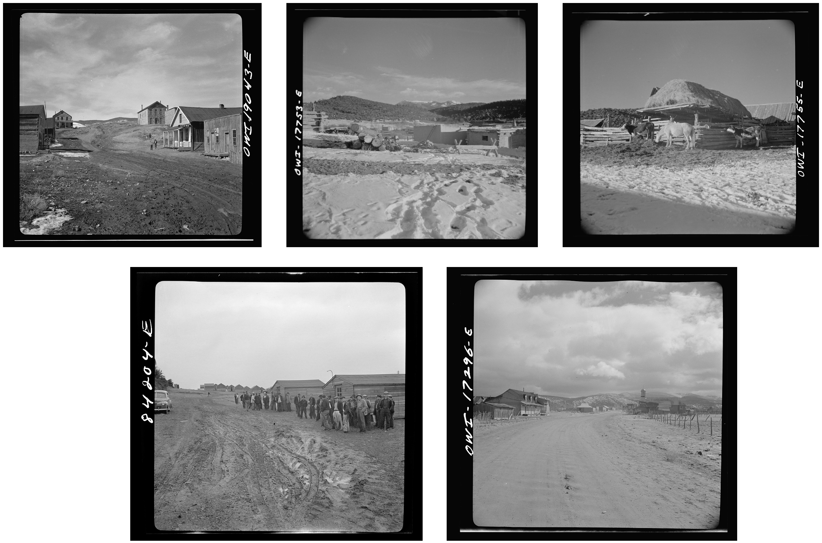
Perspective
The computational analysis helped us identify patterns in the photographic collection, but it is only through returning to the image themselves that we can fully understand.
For contrast, these are images from John Collier. His horizon is usually right at the center of the image. Notice how much of the foreground is taken up by dirt, ground, and snow.
04 – Distant Viewing | Distant → Close

Slide 19
Detecting Objects
Another way that we can use computational methods to link back to the images themselves is through the detected objects.
These are too numerous and varied to aggregate, but just pulling them out as examples shows the scope and span of the collection.
04 – Distant Viewing | Distant → Close

Slide 20
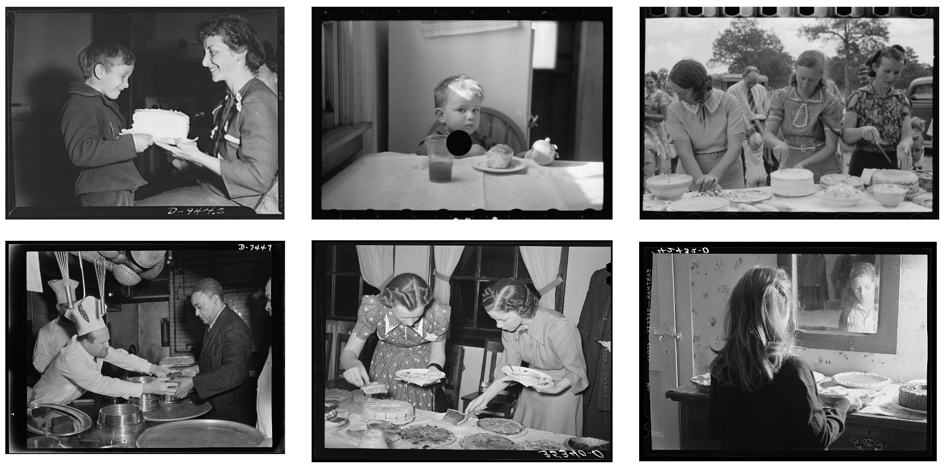
Detecting Objects
Another way that we can use computational methods to link back to the images themselves is through the detected objects.
These are too numerous and varied to aggregate, but just pulling them out as examples shows the scope and span of the collection.
Here, for example, are six images of cakes in six very different parts of the country by different photographers.
04 – Distant Viewing | Distant → Close

Slide 21
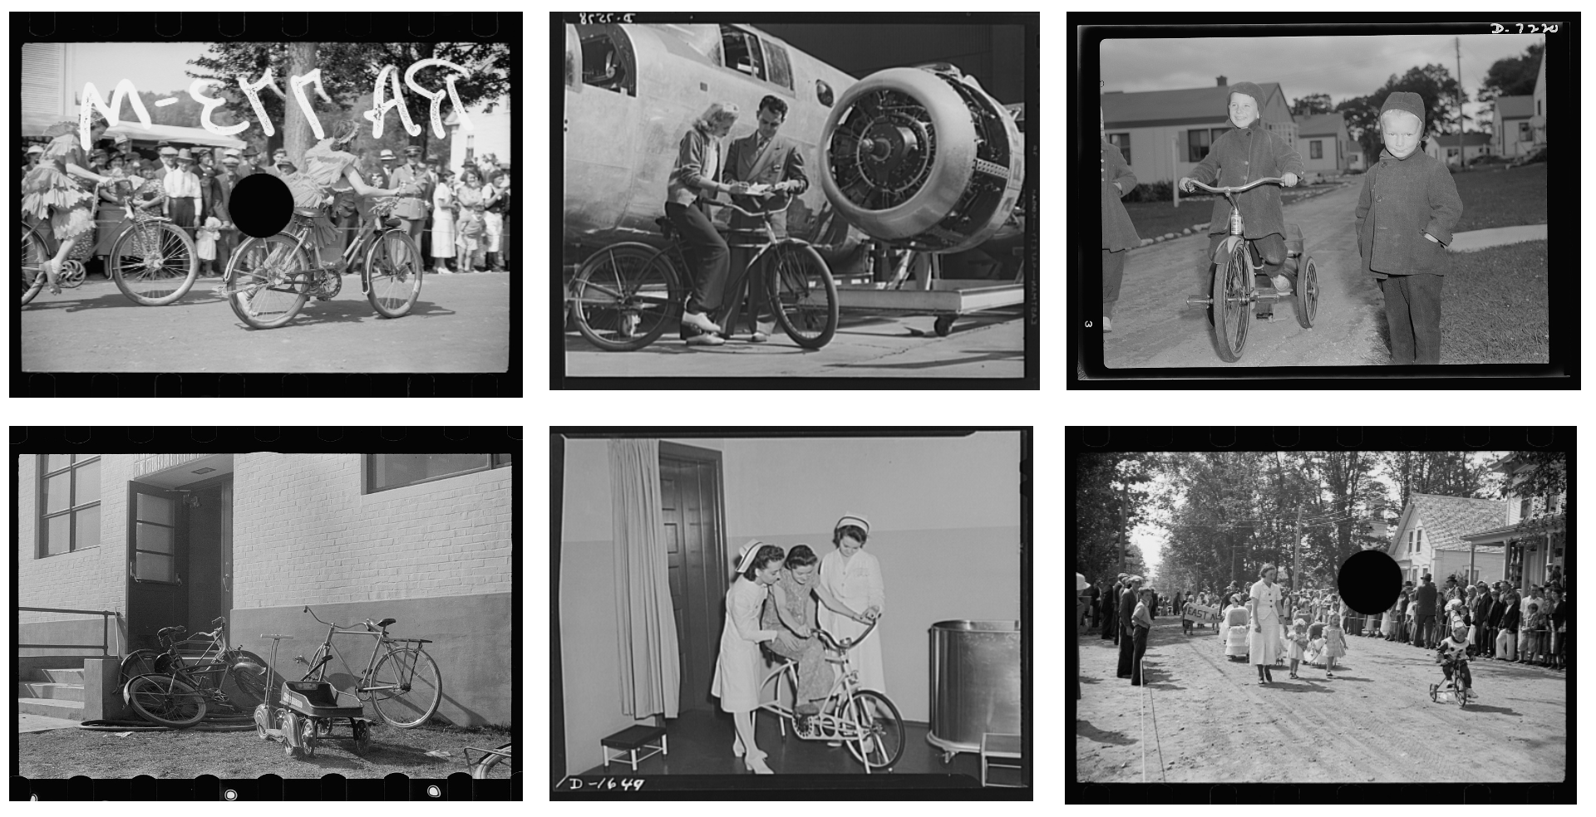
Detecting Objects
Another way that we can use computational methods to link back to the images themselves is through the detected objects.
These are too numerous and varied to aggregate, but just pulling them out as examples shows the scope and span of the collection.
Similarly, here are images of bicycles in different contexts.
04 – Distant Viewing | Distant → Close

Slide 22
5. Recovering Materiality
05 – Distant Viewing | Recovering Materiality

Slide 23
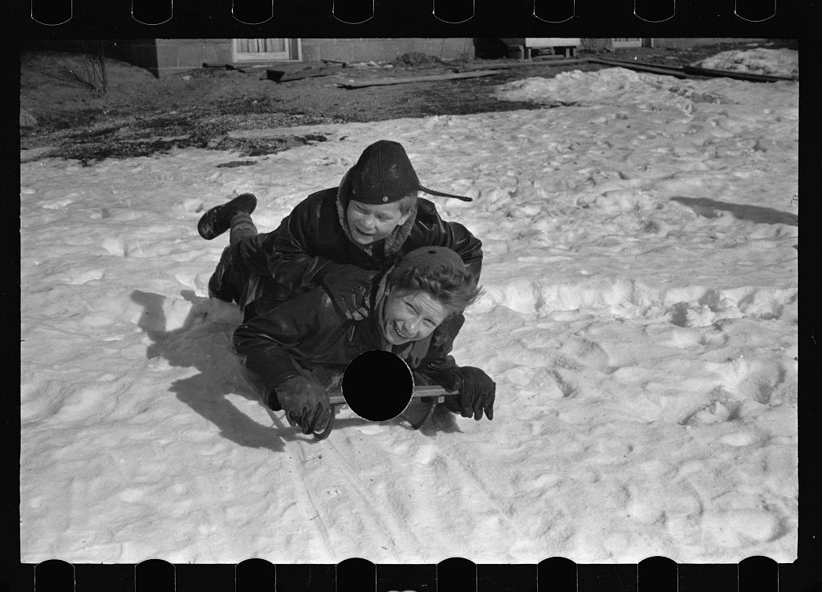
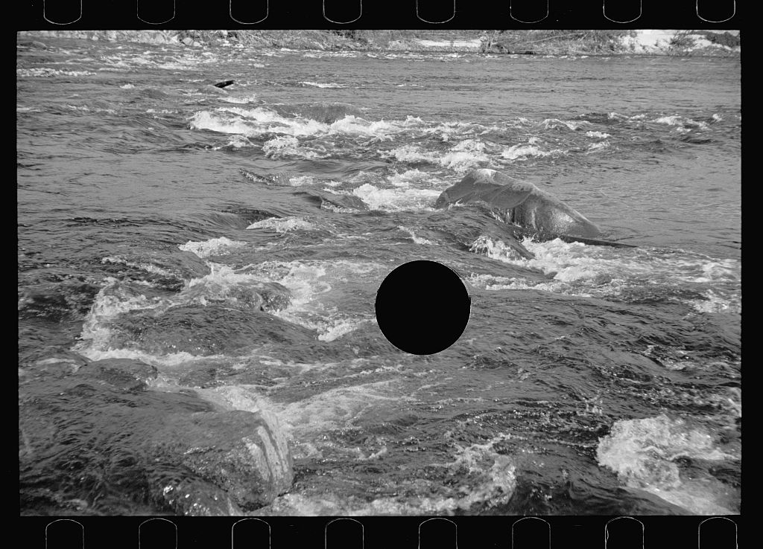
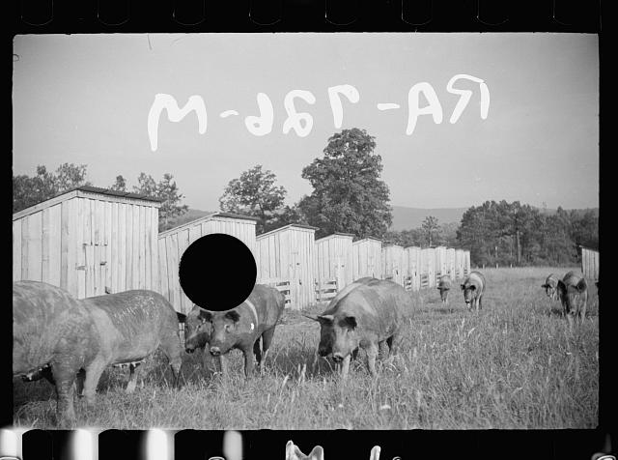
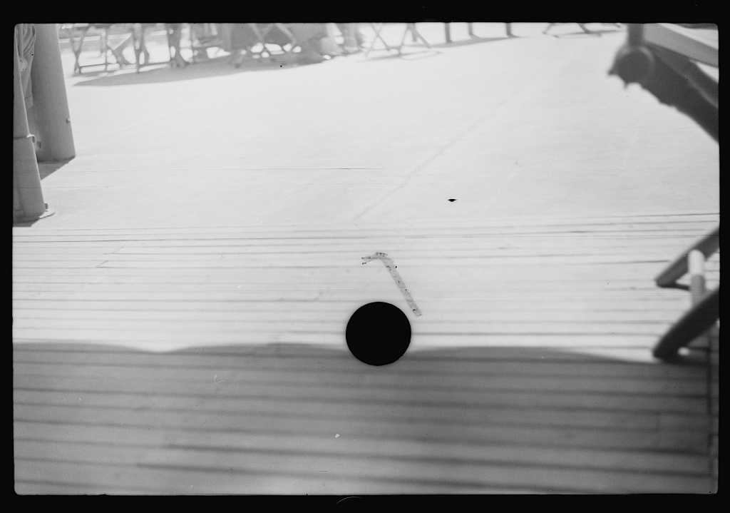
Materiality
We can even use computer vision techniques to understand the materiality of the original images themselves.
For example, several thousand of the FSA-OWI negatives were killed by having a hole punched in them. We can identify and look through these by using a specially created computer vision algorithm to generate a “killed” annotation.
05 – Distant Viewing | Recovering Materiality

Slide 24
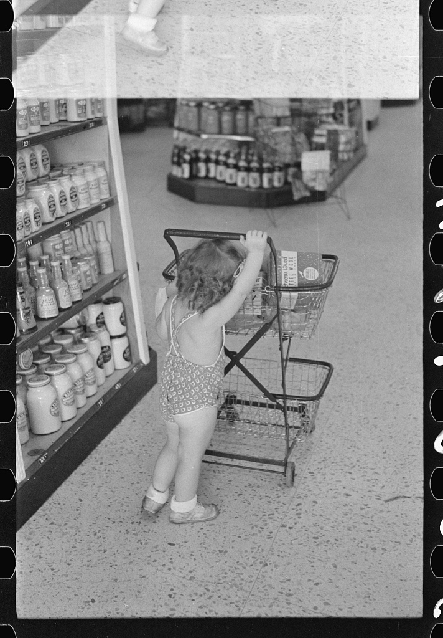
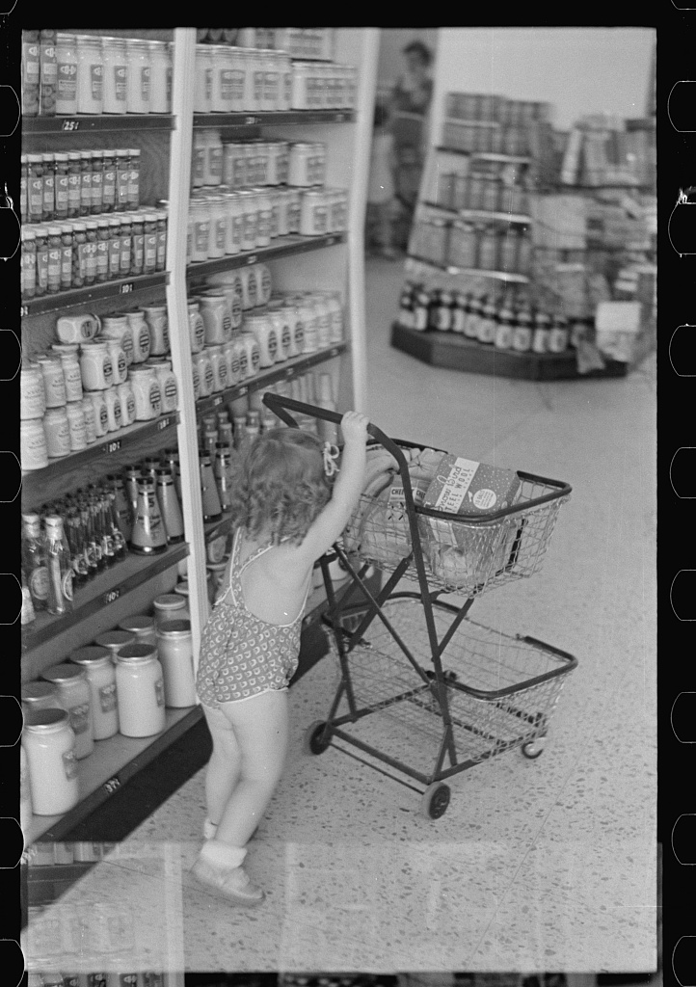
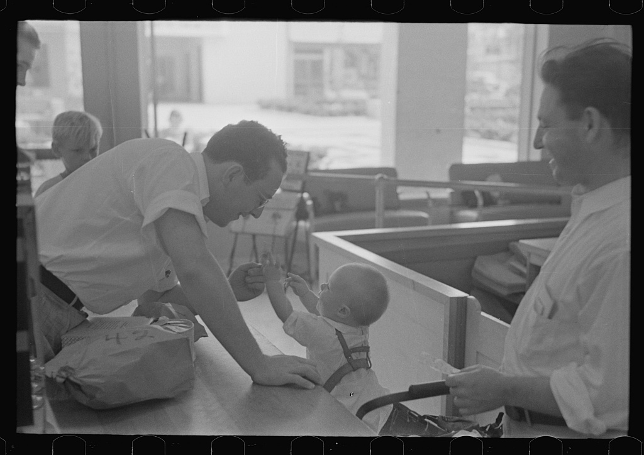
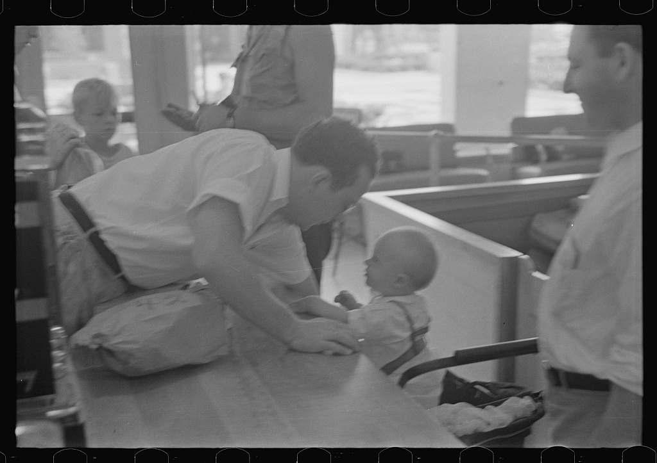
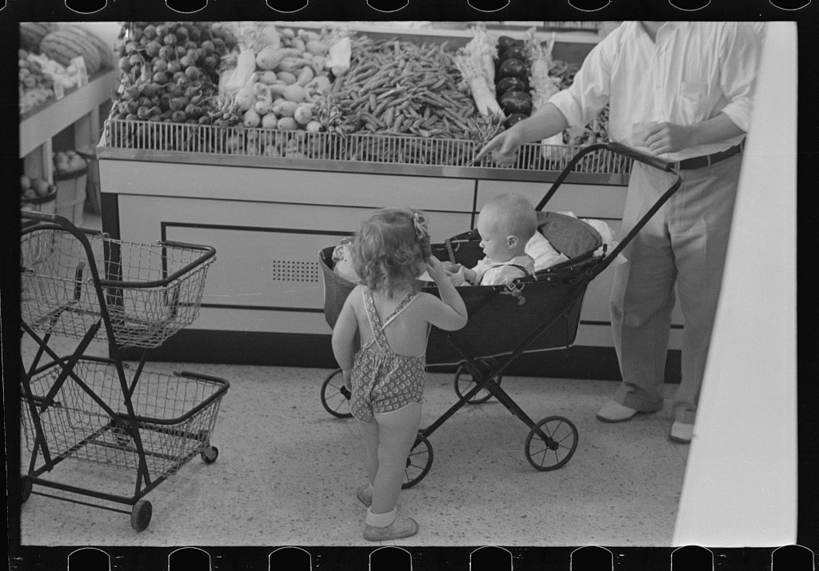
Materiality
Using a mixture of metadata and computer vision techniques, we can even begin to construct the strips of photographic negatives. This helps understand the shooting order of the photographs and offers insights into the thought process of both the photographer and the printing decisions of Roy Stryker and other FSA-OWI staff members.
Marion Post Wolcott, Prince George’s County, Maryland, USA (October 1938)
05 – Distant Viewing | Recovering Materiality

Slide 25
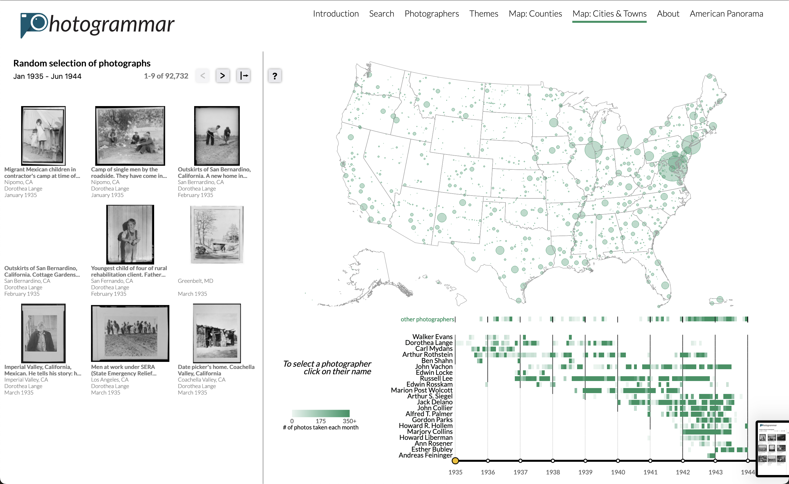
Public Project: Photogrammar
We can combine access to the aggregative analyses—both from computer vision and other DH methods—and close viewing of the images through large-scale public projects.
For example, we have built the Photogrammar.org platform for looking at the FSA-OWI collection using computer vision, textual, temporal, and spatial methods.
05 – Distant Viewing | Recovering Materiality

Slide 26
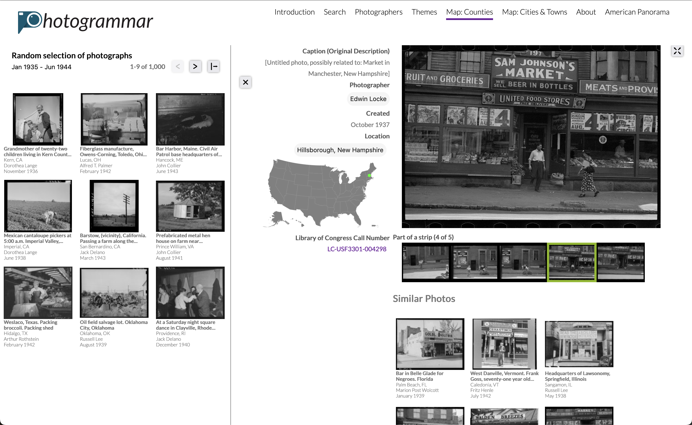
Public Project: Photogrammar
We can combine access to the aggregative analyses—both from computer vision and other DH methods—and close viewing of the images through large-scale public projects.
For example, we have built the Photogrammar.org platform for looking at the FSA-OWI collection using computer vision, textual, temporal, and spatial methods.
05 – Distant Viewing | Recovering Materiality

Slide 27
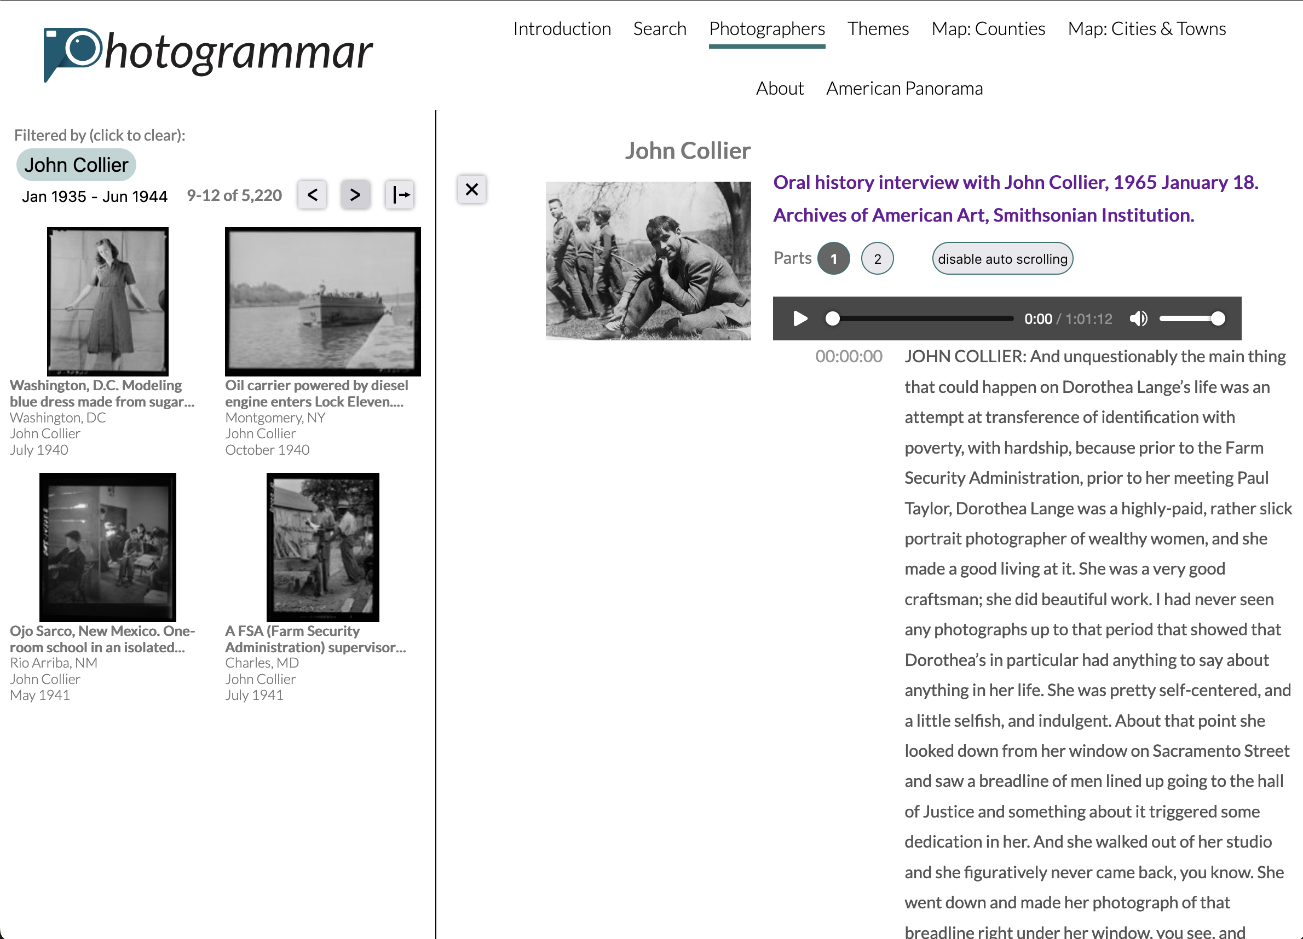
Public Projects: Photogrammar
Digital projects allow us to further combine different layers of information to further contextualize visual materials.
For the FSA-OWI collection, we have been able to combine oral histories (both transcripts and the sound files themselves) with the FSA-OWI photographers and their contributions to the archive.
05 – Distant Viewing | Recovering Materiality

Slide 28
6. Close → Distant
06 – Distant Viewing | Close → Distant

Slide 29
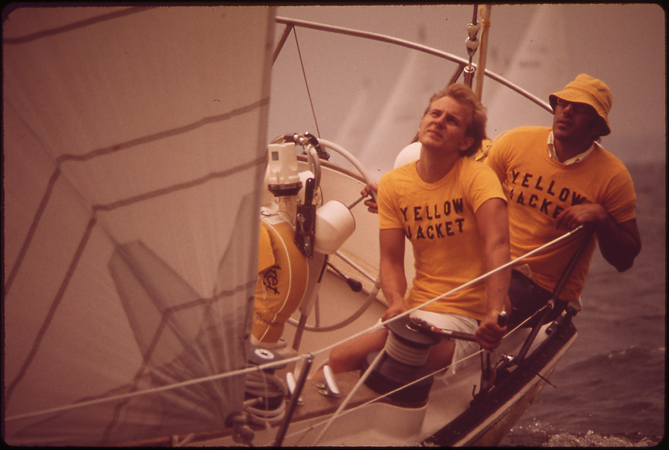
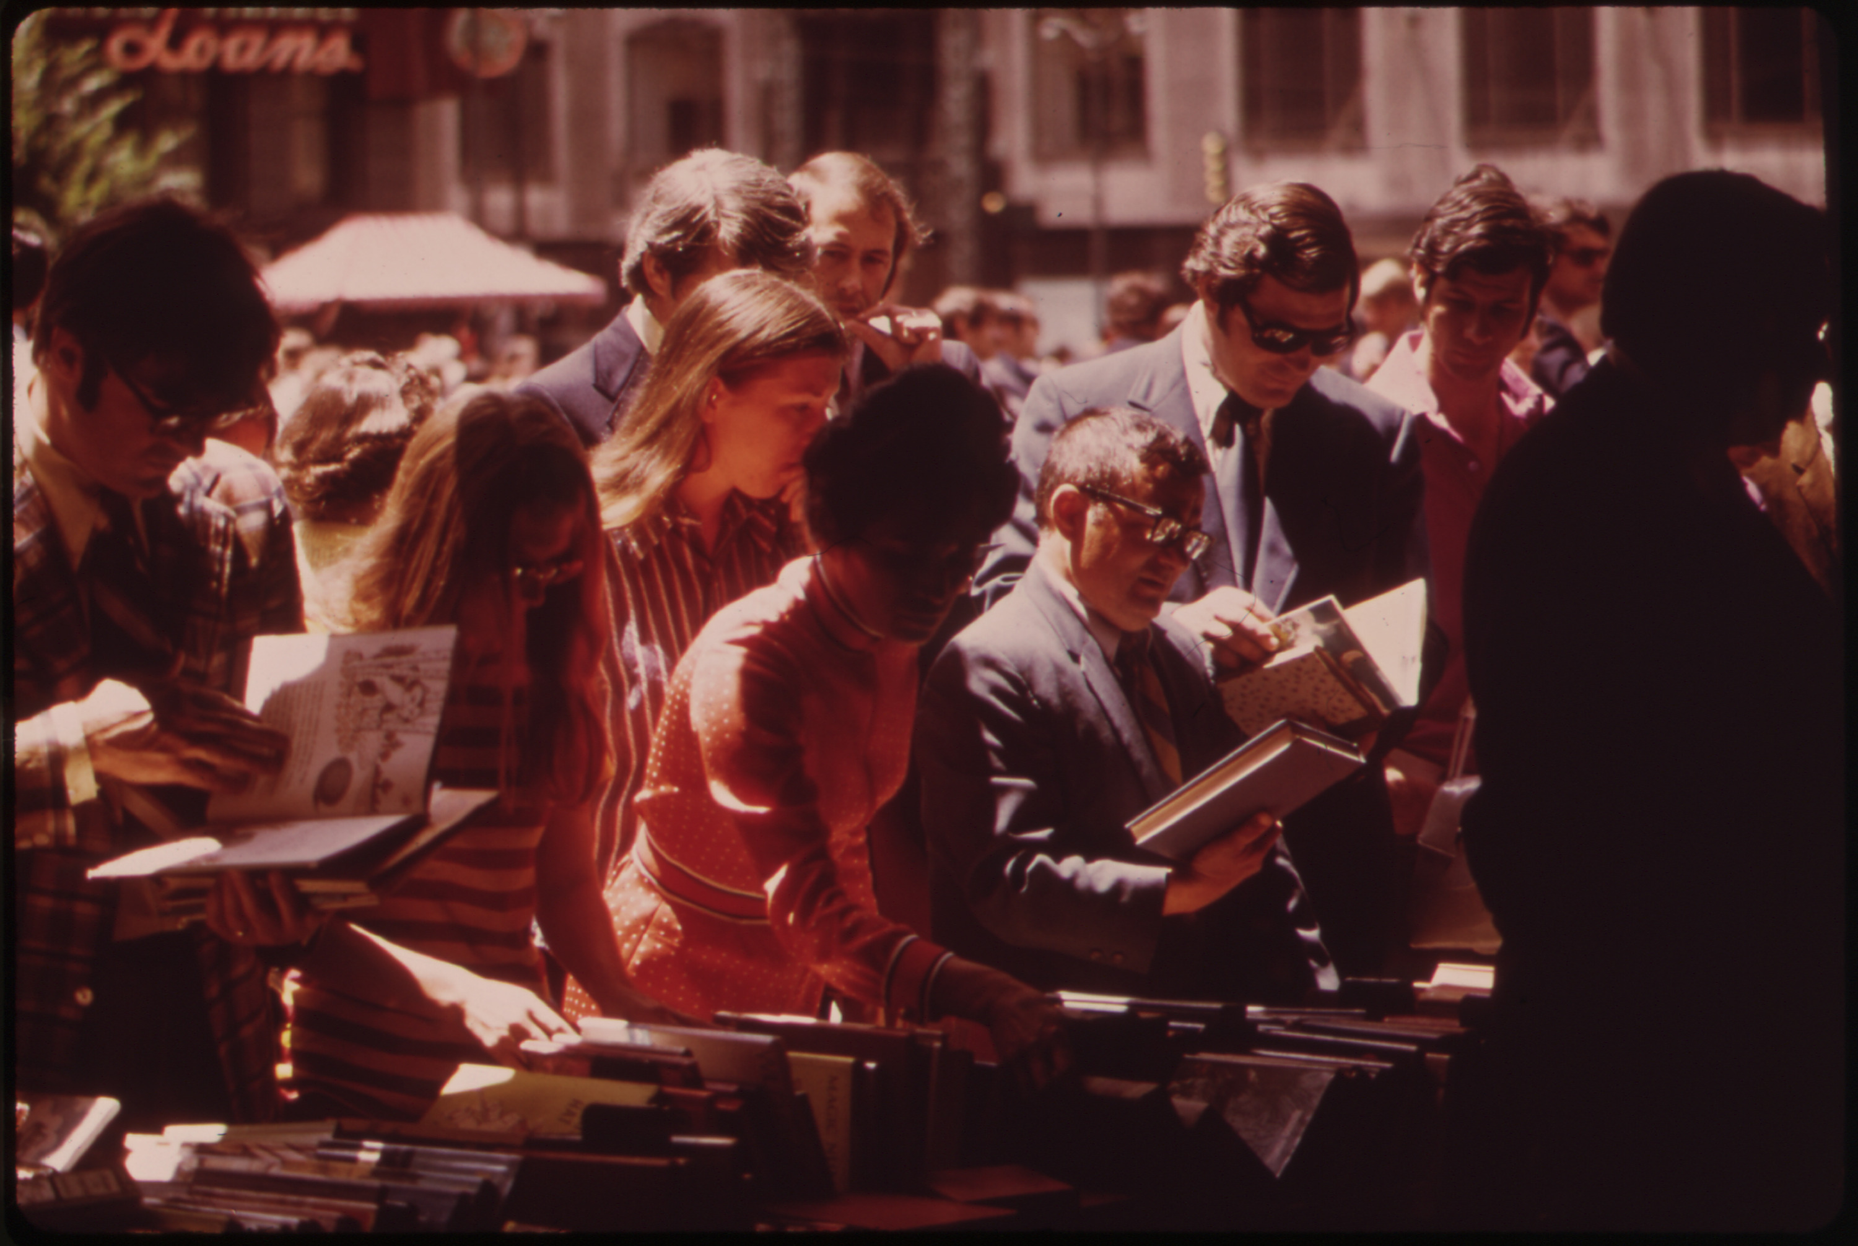
DOCUMERICA
The workflow of an analysis between close and distant, material and digital is not always predictable.
We are working on a new project focused on the 16k images taken the US Environmental Protection Agency in the 1970s under the name DOCUMERICA. The slides that were digitized by the National Archives were heavily damaged, causing a consistent red-shift to each of the images.
06 – Distant Viewing | Close → Distant

Slide 30
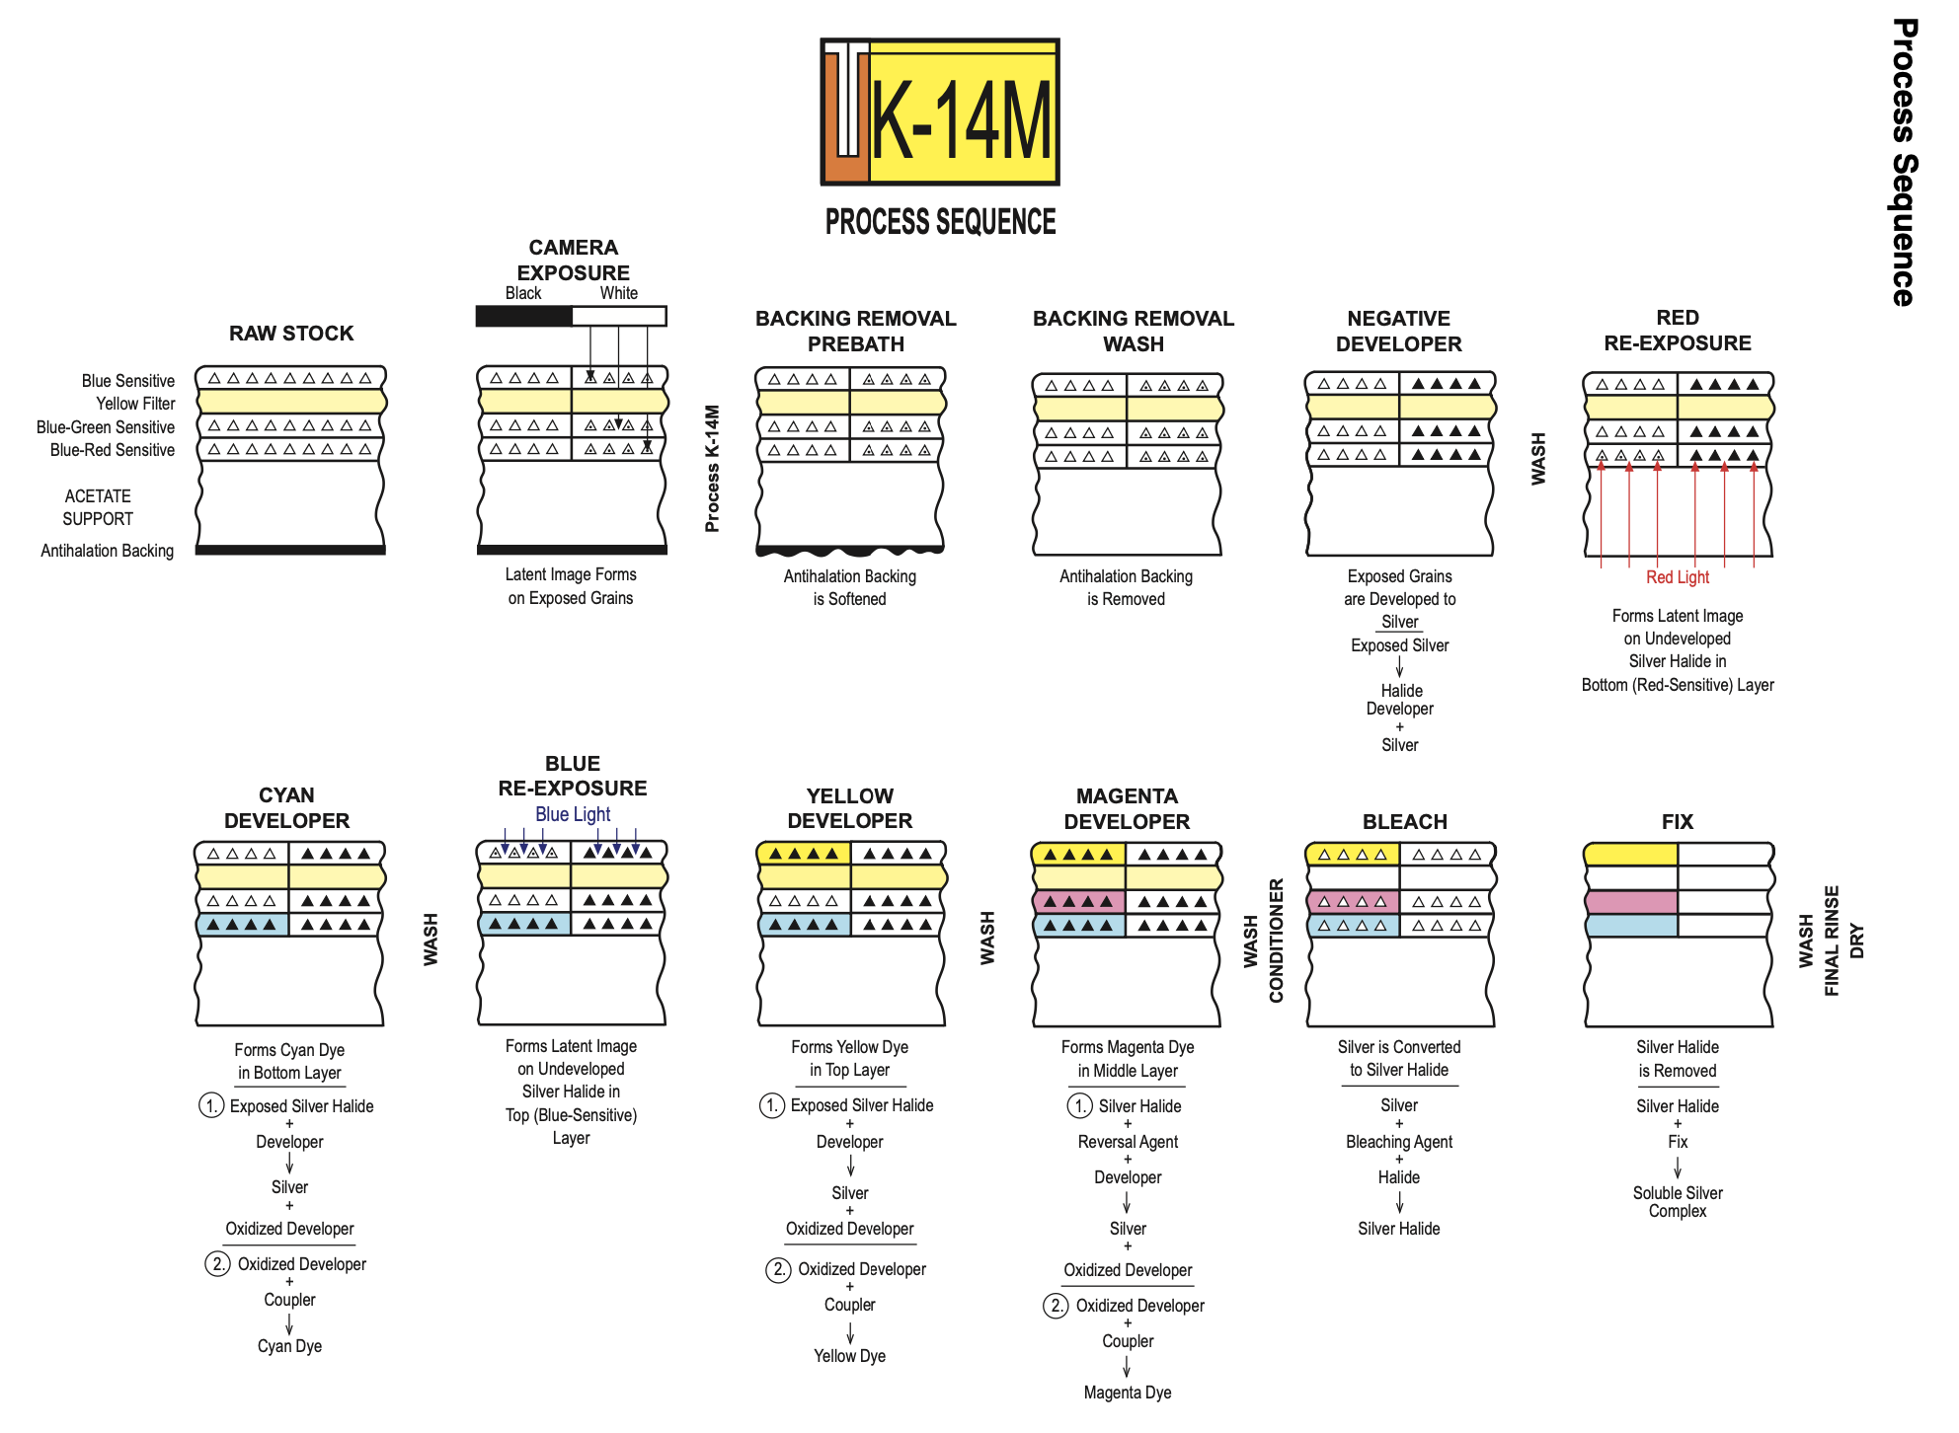
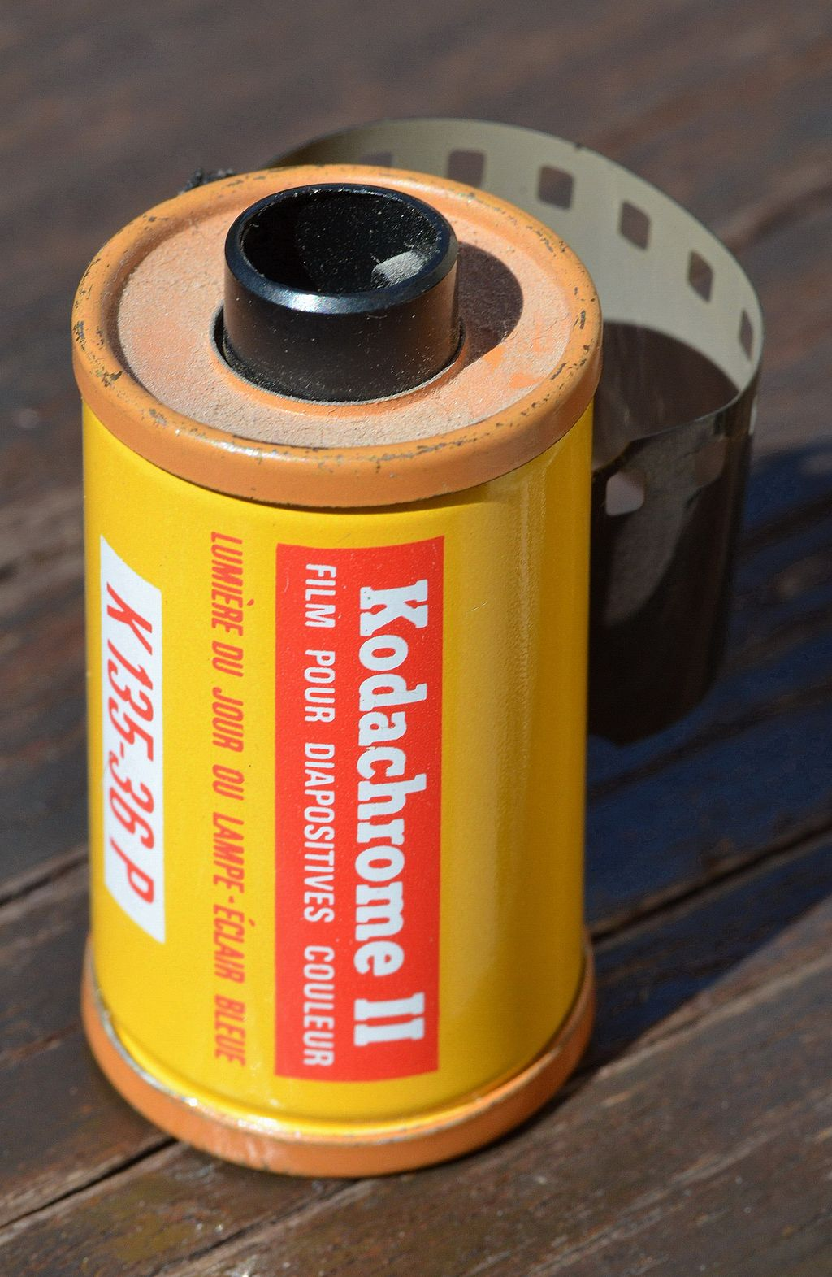
DOCUMERICA
What if we consider the materiality of the slides themselves through the underlying chemistry of the Kodachrome and Ektachrome photographic slides?
06 – Distant Viewing | Close → Distant

Slide 31
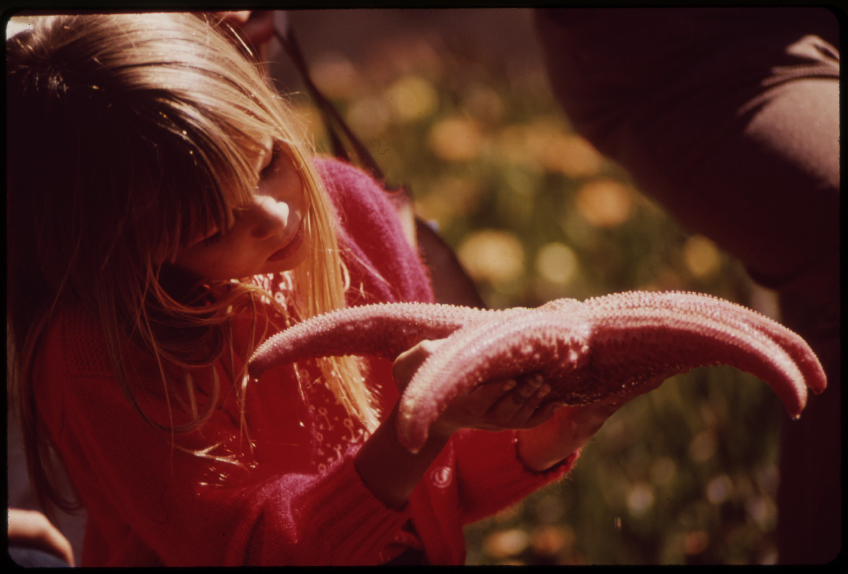
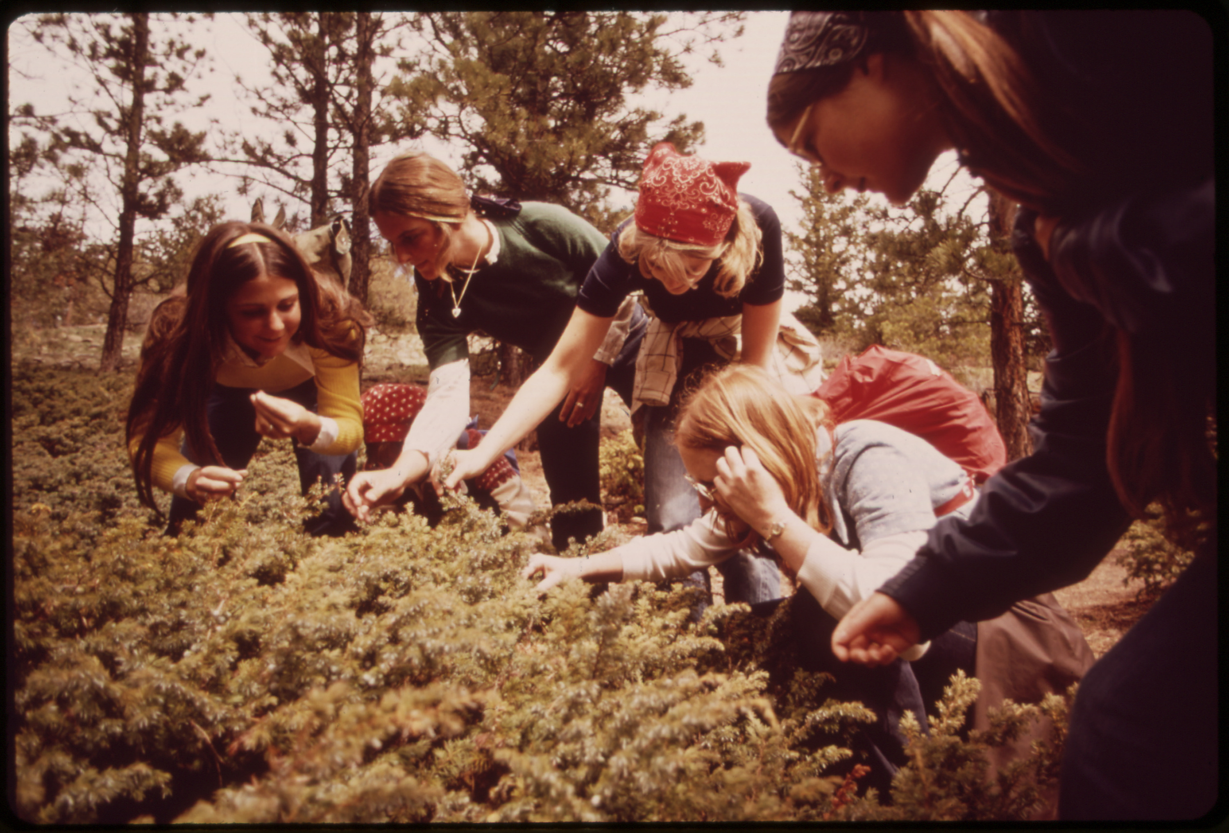
DOCUMERICA
We have been able to make, while not perfect reproductions, much more aesthetically pleasing and natural looking images by color correcting the damaged digitized slides.
ORIGINAL
CORRECTED
06 – Distant Viewing | Close → Distant

Slide 32
7. Tools
07 – Distant Viewing | Tools

Slide 33
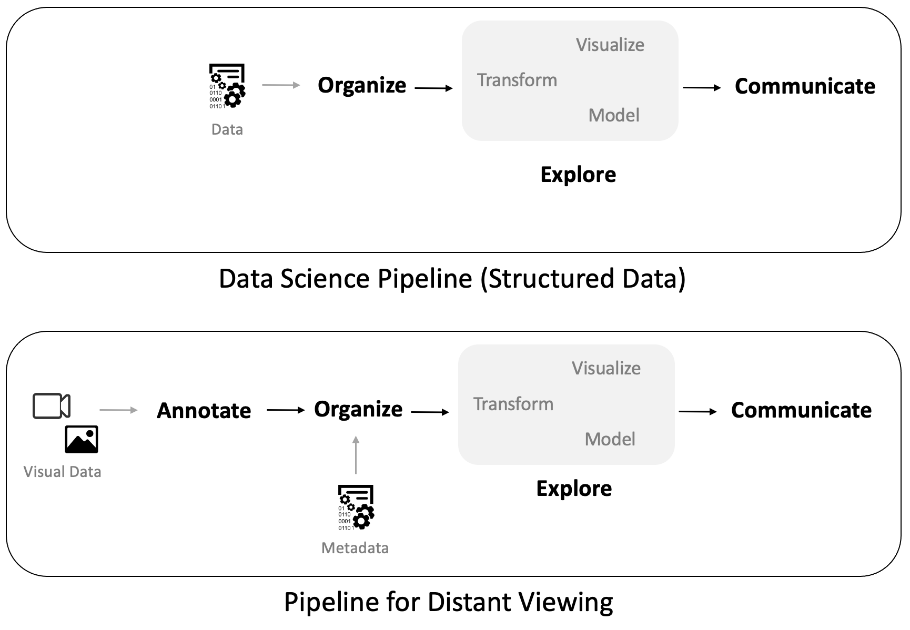
DVLab Tools
The theory of Distant Viewing yields consequences for how one can integrate data science techniques into applications of digitized collections of art and other artefacts of visual culture.
These changes often require additional tools and software to augment those that exist for working with structured and textual data.
07 – Distant Viewing | Tools

Slide 34
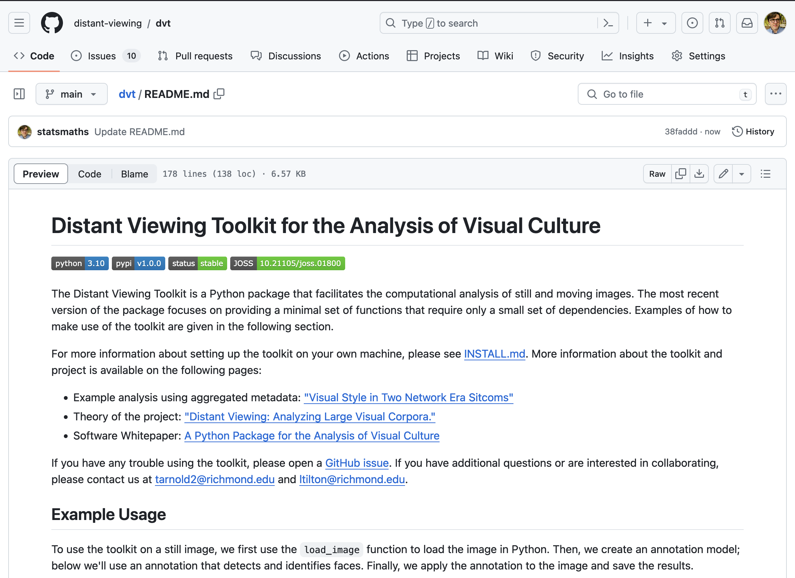
DV Toolkit: Python
Open-source software that provides a set of functions that allows users with some basic programing knowledge to apply state-of-the-art computer vision algorithms to both still and moving images.
Can be downloaded from GitHub for local usage or run directly in Google’s Colab system with no set-up involved.
07 – Distant Viewing | Tools

Slide 35
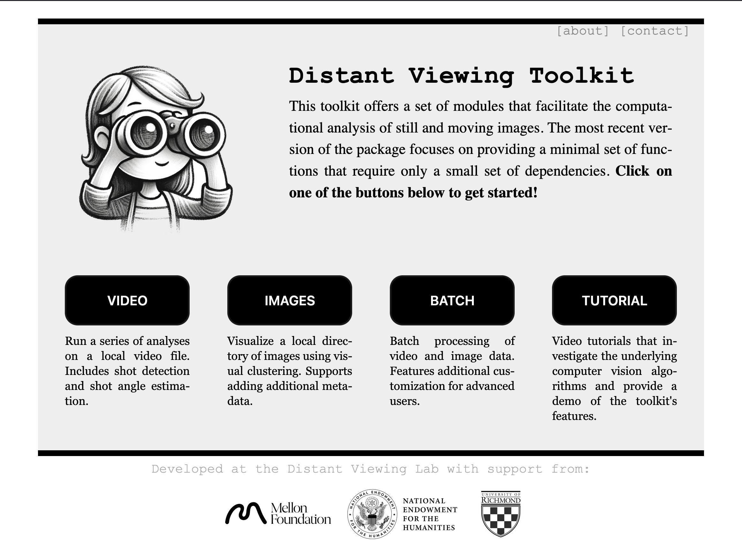
DV Toolkit: GUI
(Coming soon!)
A completely web-based version with similar functionality that requires absolutely no programing.
Provides built-in visualization tools to understand collections of both still and moving images.
Also able to download annotations that can be archived and/or loaded into other data analysis software.
07 – Distant Viewing | Tools

Slide 36
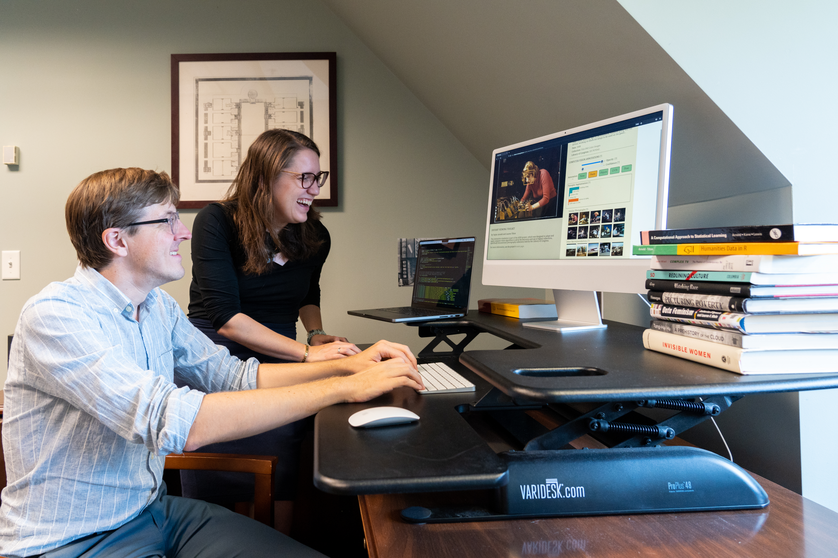
THANK YOU!
Please get in touch!
distantviewing.org
tarnold2@richmond.edu
ltilton@richmond.edu

